Slide 1



Slide 2
OBJECTIVES
To understand the concept of Electronic Payment System and its security services.
To bring out solution in the form of applications to uproot Electronic Payment.
To understand working of various Electronic Payment System based applications.

Slide 3
What Electronic Payment system is?
Electronic payment system is a system which helps the customer or user to make online payment for their shopping.
To transfer money over the Internet.
Methods of traditional payment.
oCheck, credit card, or cash.
Methods of electronic payment.
oElectronic cash, software wallets, smart cards, and credit/debit cards.

Slide 4
Some Examples Of EPS:-
Online reservation
Online bill payment
Online order placing (nirulas)
Online ticket booking ( Movie)

Slide 5
Two storage methods
On-line
Individual does not have possession personally of electronic cash
Trusted third party, e.g. online bank, holds customers’ cash accounts
Off-line
Customer holds cash on smart card or software wallet
Fraud and double spending require tamper-proof encryption

Slide 6
E- CASH
E- WALLETS
Typesof EPS
SMART CARDS
CREDIT CARDS

Slide 7
E-Cash
A system that allows a person to pay for goods or services by transmitting a number from one computer to another.
Like the serial numbers on real currency notes, the E-cash numbers are unique.
This is issued by a bank and represents a specified sum of real money.
It is anonymous and reusable.

Slide 8
Electronic Cash Security
Complex cryptographic algorithms prevent double spending
 Anonymity is preserved unless double spending is attempted
Serial numbers can allow tracing to prevent money laundering

Slide 9

E-Cash Processing
Merchant
1. Consumer buys e-cash from Bank
2. Bank sends e-cash bits to consumer (after charging that amount plus fee)
5
4
3. Consumer sends e-cash to merchant
Bank
3
4. Merchant checks with Bank that e-cash is valid (check for forgery or fraud)
2
5. Bank verifies that e-cash is valid
1
6. Parties complete transaction
Consumer

Slide 10
E-Wallet
The E-wallet is another payment scheme that operates like a carrier of e-cash and other information.
The aim is to give shoppers a single, simple, and secure way of carrying currency electronically.
Trust is the basis of the e-wallet as a form of electronic payment.

Slide 11
Procedure for using an e-wallet
1. Decide on an online site where you would like to shop.
3. Download a wallet from the merchant’s website.
5. Fill out personal information such as your credit card number, name, address and phone number, and where merchandise should be shipped.
7. When you are ready to buy, click on the wallet button, the buying process is fully executed.

Slide 12
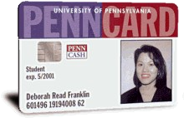
Smart Cards
A smart card, is any pocket-sized card with embedded integrated circuits which can process data
This implies that it can receive input which is processed and delivered as an output

Slide 13
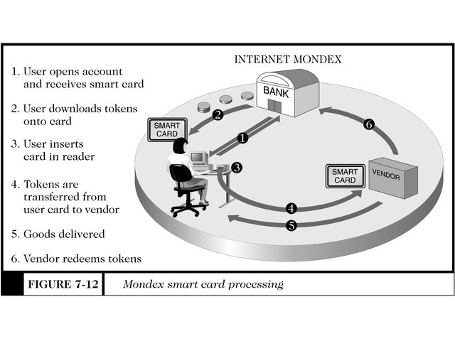
Smart card Processing

Slide 14
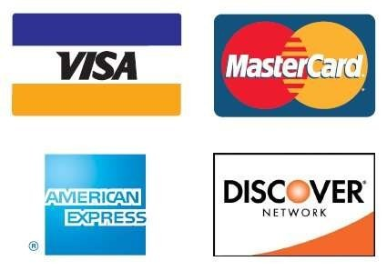
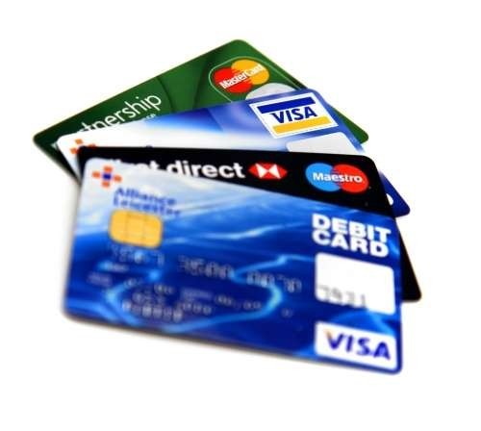
Credit cards
It is a Plastic Card having a Magnetic Number and code on it.
It has Some fixed amount to spend.
Customer has to repay the spend amount after sometime.

Slide 15
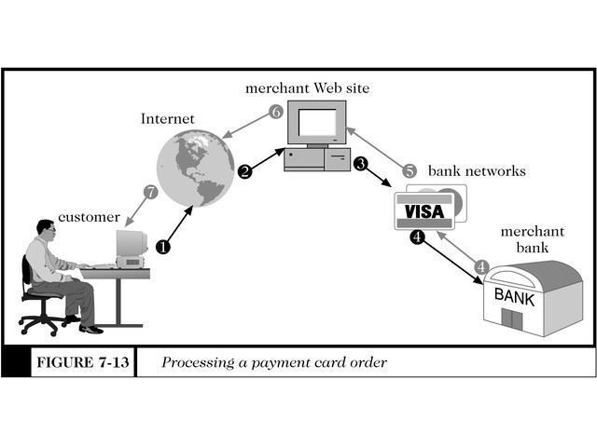
Processing a Credit cards payment

Slide 16
Risk in using Credit cards
Operational Risk
Credit Risk
Legal Risk

Slide 17

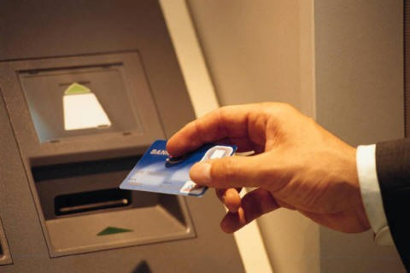
Security Requirements of EPS
Integrity
Privacy
Safety
Authentication
Non-repudiation

Slide 18
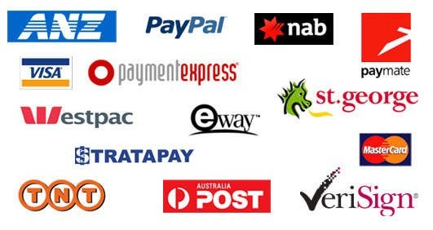
What Is payment Gateways??
A payment gateway is an e-commerce application service provider service that authorizes payments for e-businesses, online Shopping, etc.
Payment gateway protects credit cards details encrypting sensitive information, such as credit card numbers, to ensure that information passes securely between the customer and the merchant and also between merchant and payment processor.

Slide 19
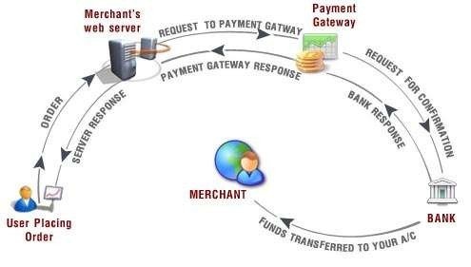
How It works??

